Slide 1
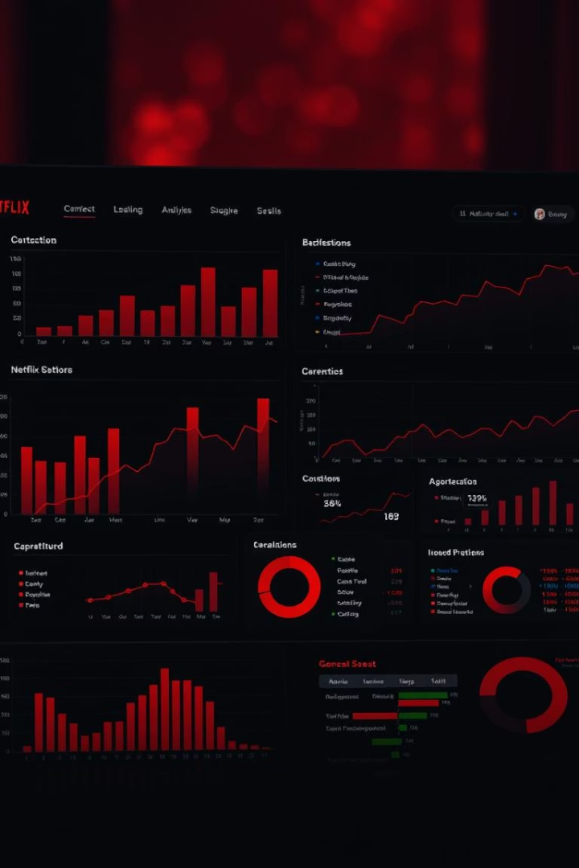

Netflix Data Analysis Dashboard
A Power BI Report
by Priya Mohan

Slide 2

Project Overview & Objectives
1
Analyze Content
2
Derive Insights
3
Visualize Data
Examine Netflix movies and TV shows.
Understand trends in releases, genres, and distribution.
Create interactive reports using Power BI.

Slide 3





Data Source & Tools Used
Netflix Dataset
Pandas (Python)
Power Query
For splitting columns and creating related tables.
Sourced from Kaggle.
Used for data cleaning and handling missing values.
Power BI
For data modeling, DAX, and dashboard creation.

Slide 4





Data Cleaning & Transformation
Handle Missing Values
Removed nulls in Date_Added, Director, etc.
Split Fields
Separated multi-director/cast/genre into rows.
Create Lookups
Generated tables for Director, Cast, and Genre.
Standardize Formats
Ensured consistent dates, text, and durations.

Slide 5
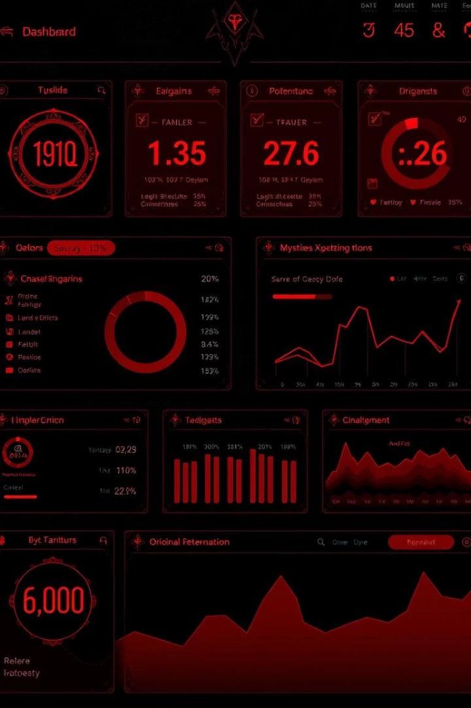
Key Summary Statistics
8,798
Total Titles
Including movies and TV shows.
6,122
Movies
Approximately 69.6% of content.
2,676
TV Shows
Approximately 30.4% of content.
4,991
Total Directors
Contributing to the content library.

Slide 6
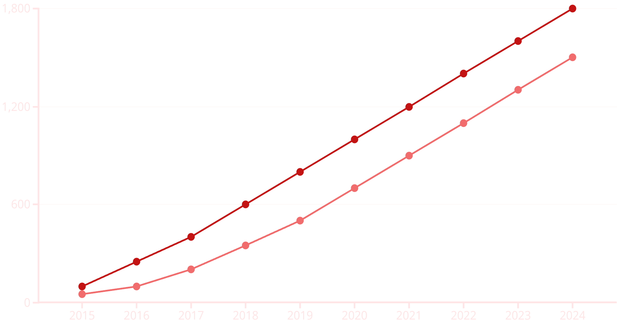
Content Growth Over Years
Movies
TV Shows
Netflix content has grown rapidly since 2015. TV Shows began rising significantly post-2017, indicating a shift in content strategy.

Slide 7
Top Producing Countries
Dominant Producers
Emerging Contributions
US and India lead content production.
UK, South Korea, and Japan show growing presence.

Slide 8

Challenges & Solutions
Multiple Values
Duplicate Content
Directors/cast per row were split using Power Query.
Duplicate titles/descriptions were removed or normalized.
Data Relationships
Index linking across tables was managed in the model view.

Slide 9
THANK YOU
We appreciate your time and attention. Looking forward to your questions and feedback!

